Slide 1
THEIA Prototype Mock-Up
TEAM EV
Austin Aragon, Justus Jones, Young Kim, Zichuo Wang, James Zuniga
"THEIA is used by voice, touch, and vibration. The screen is a bonus, not a must."

Slide 2
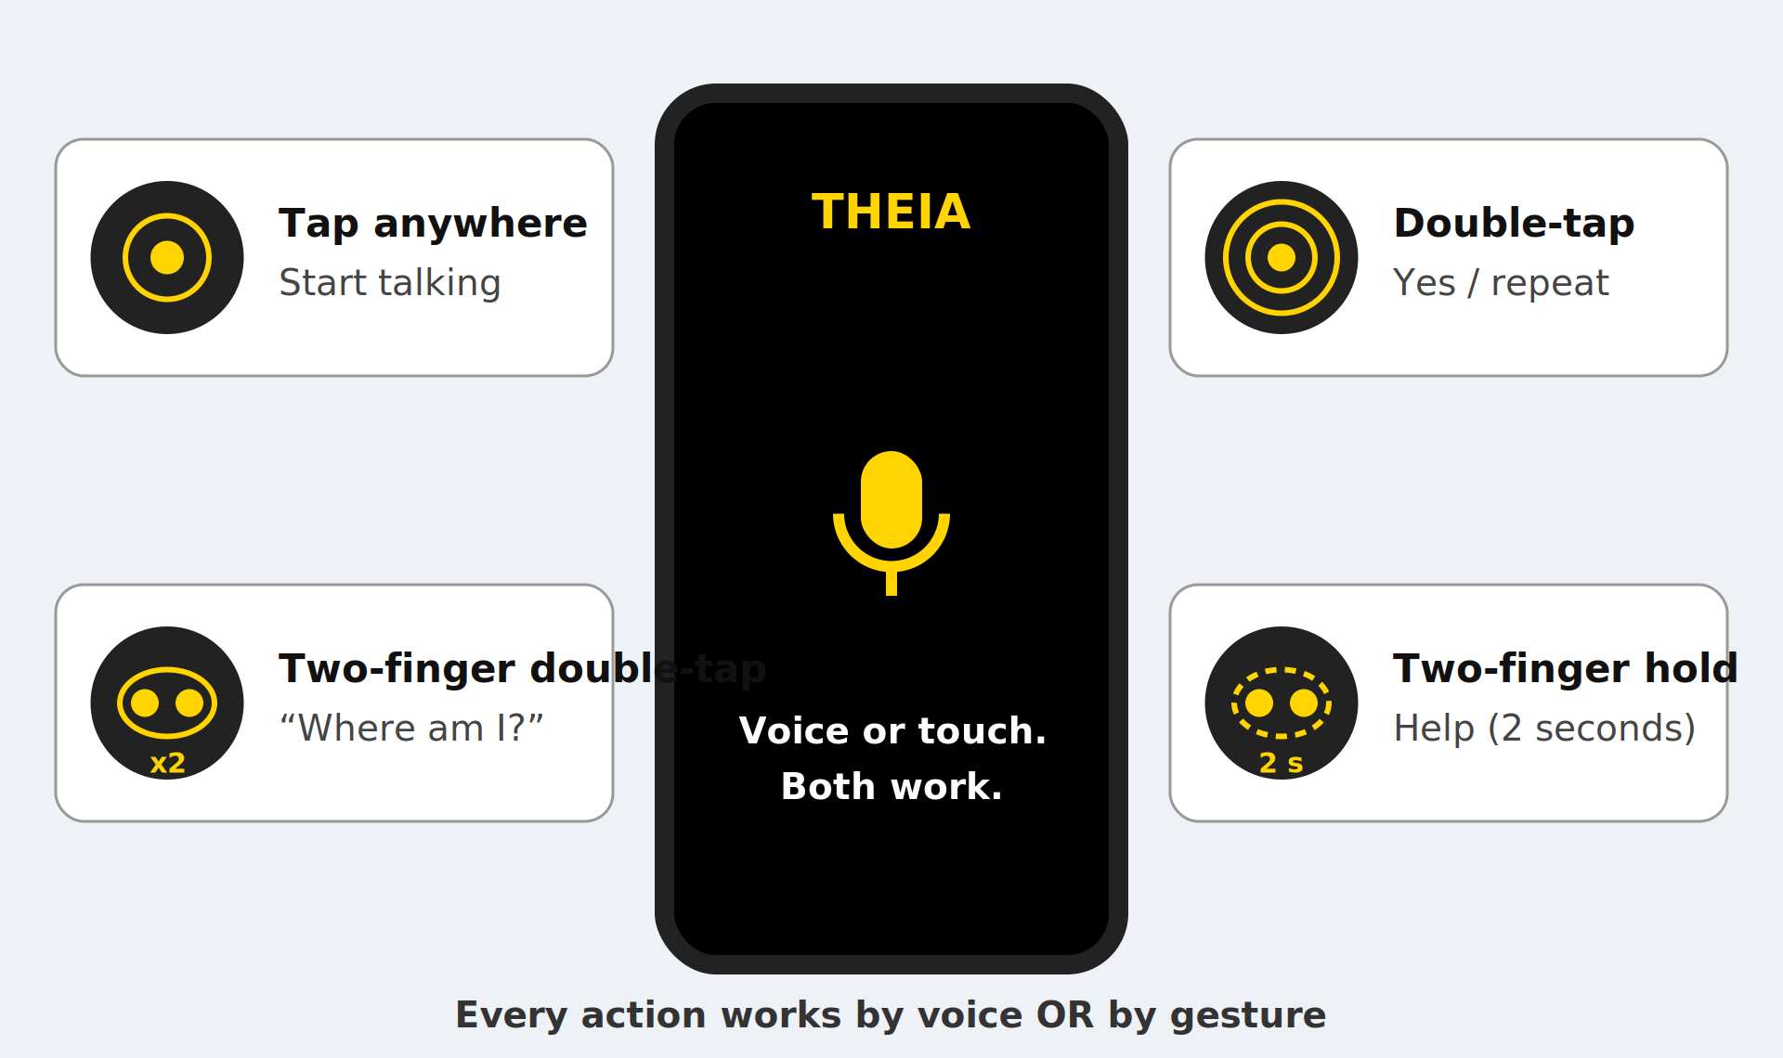
How the user controls THEIA

Slide 3
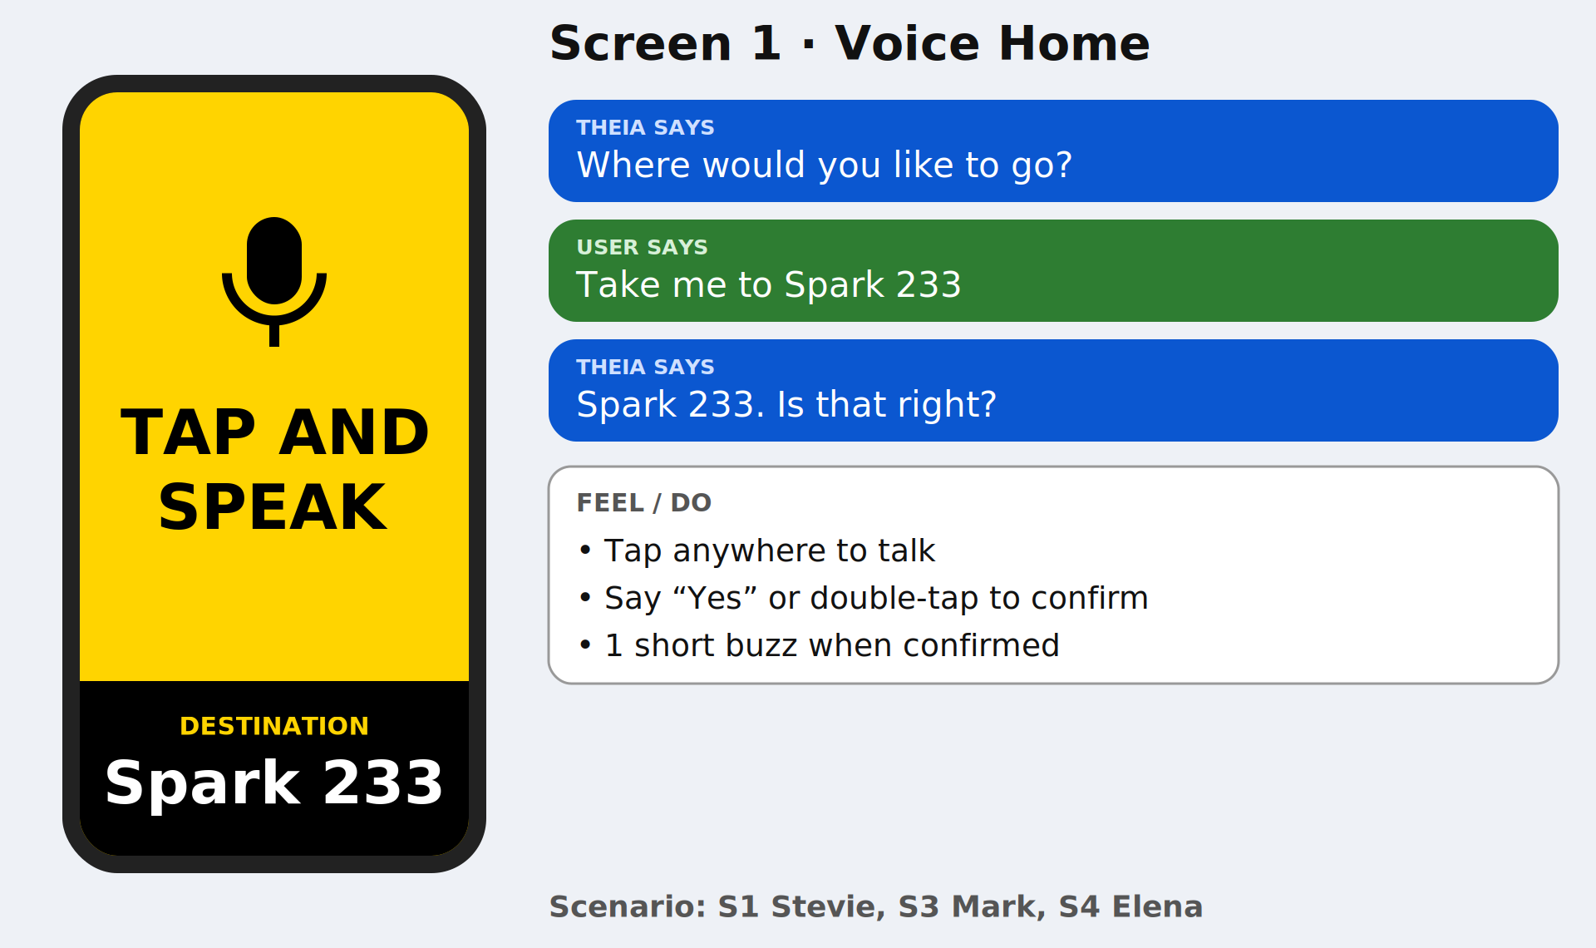
Screen 1, Voice Home
Tap anywhere to talk. Say "Yes" or double-tap to confirm. Short buzz when confirmed.

Slide 4
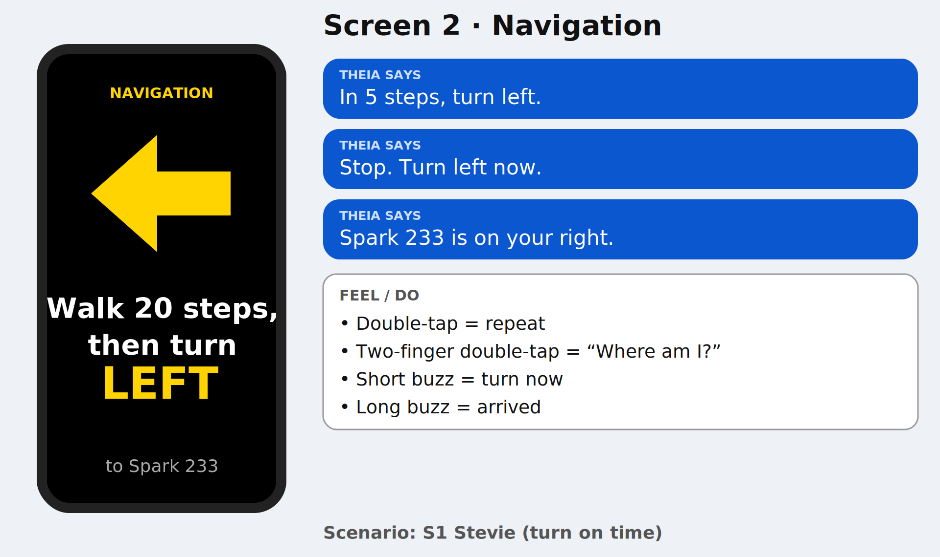
Screen 2, Navigation (non-elevator)
Double-tap = repeat. Two-finger double-tap = "Where am I?" Short buzz = turn now. Long buzz = arrived.

Slide 5
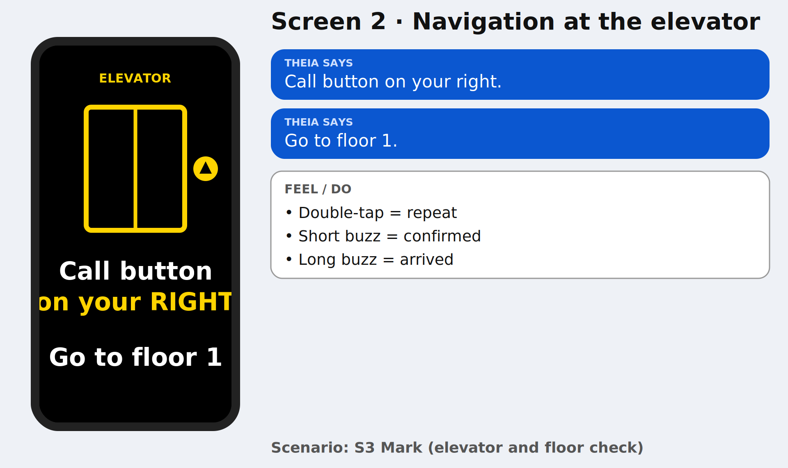
Screen 2, Navigation (elevator)
Short buzz at the elevator. THEIA says the call button side and the floor.

Slide 6
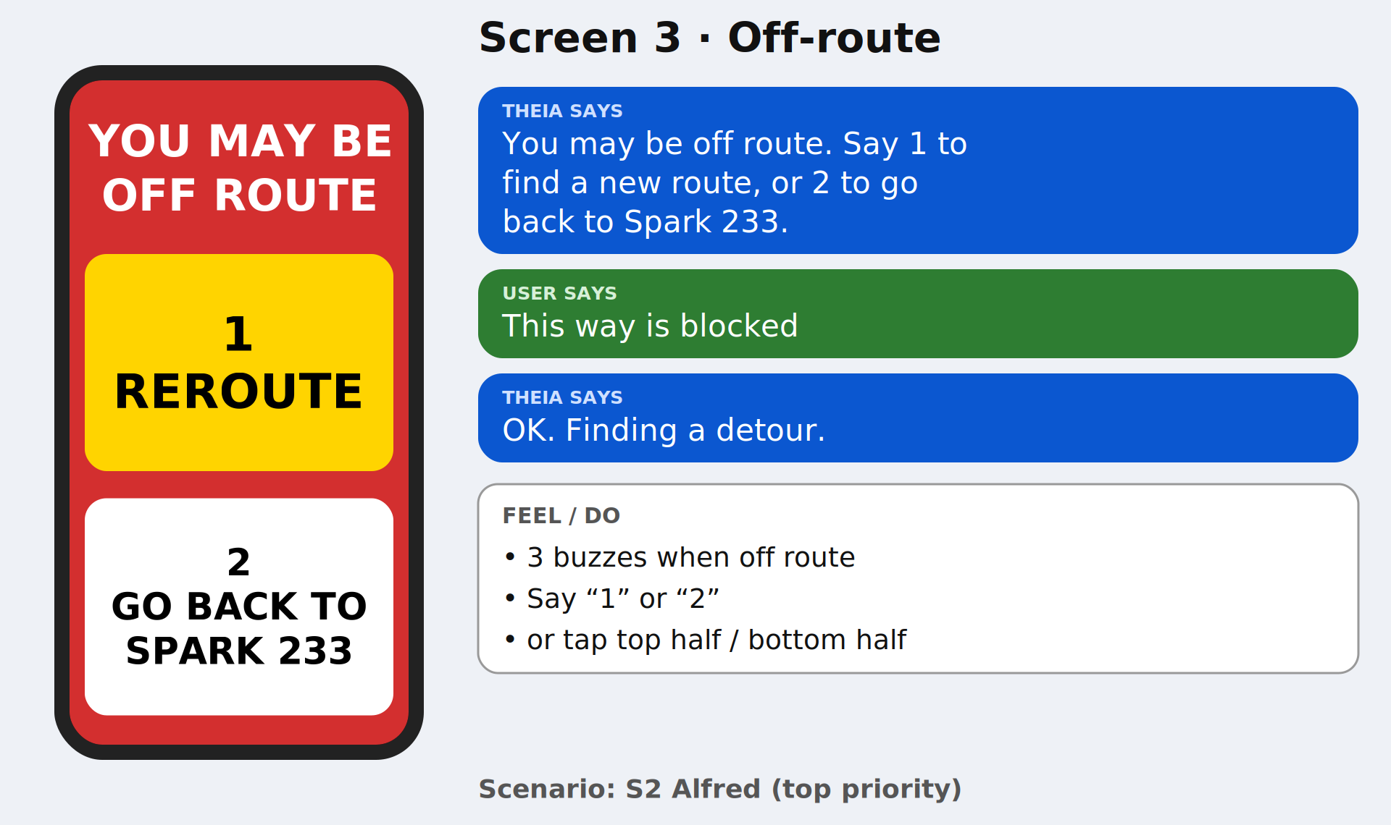
Screen 3, Off-route
3 buzzes when off route. Say "1" or "2", or tap the top half or bottom half of the screen.

Slide 7
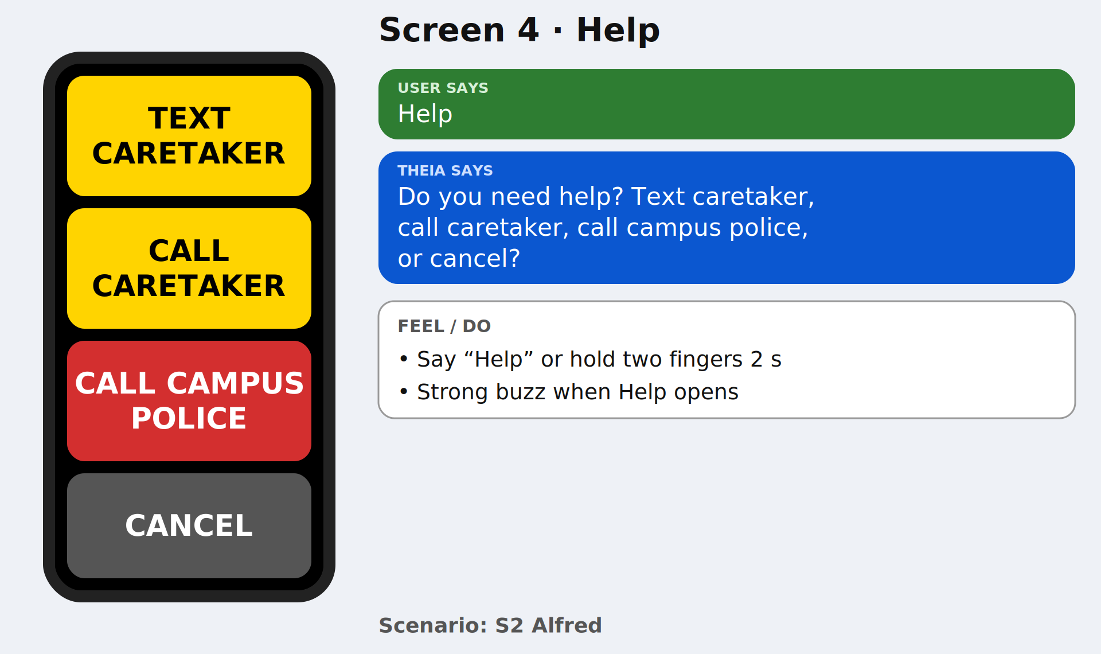
Screen 4, Help
Say "Help", or hold two fingers on the screen. Strong buzz when the help screen opens.

Slide 8
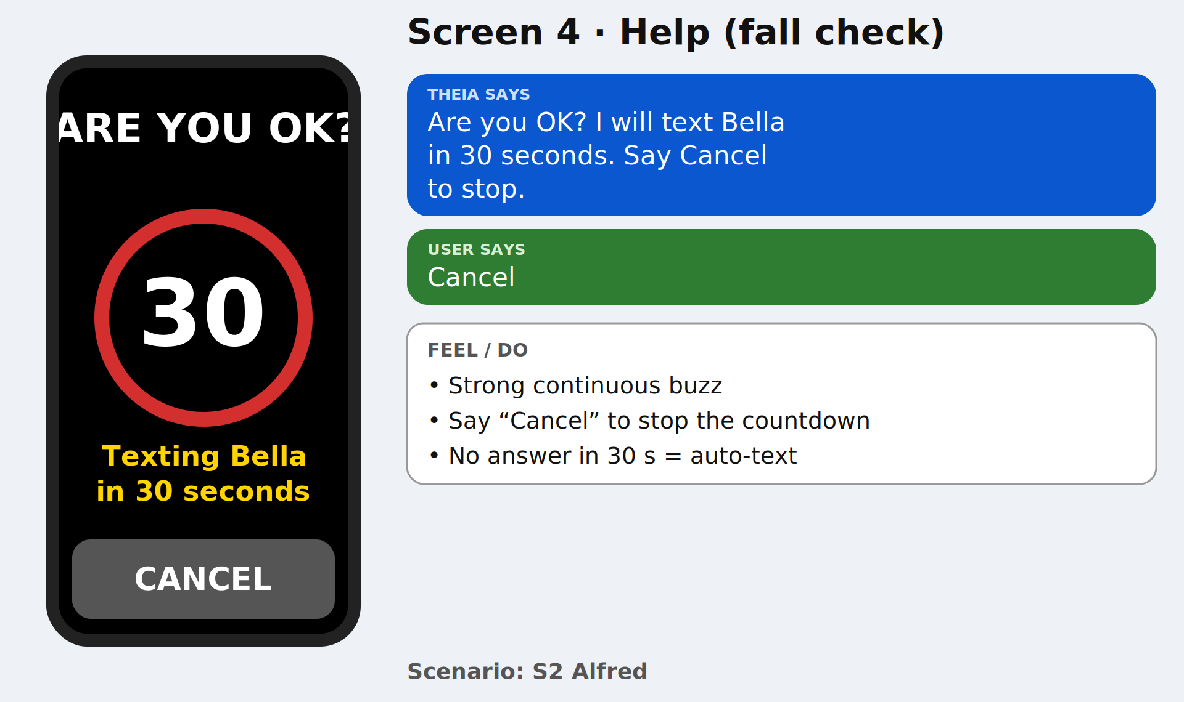
Screen 4, Help (fall check)

Slide 9
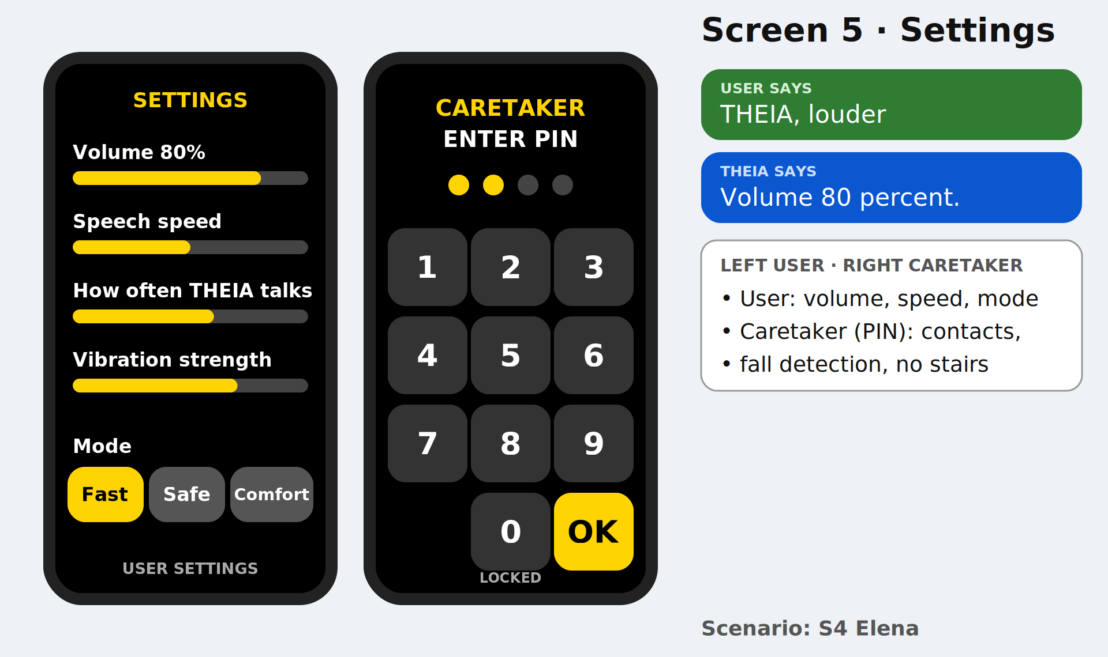
Screen 5, Settings
Say "THEIA, louder" to change a setting. Caretaker settings need the PIN.

Slide 10
Voice commands
“User says ____” | THEIA responds
"Take me to ___" | Starts a route
"Where am I?" | Tells building, floor, nearest room, which way you face
"Repeat" | Says the last instruction again
"This way is blocked" | Finds a detour
"Help" | Opens the Help screen
"Cancel" | Stops the current action or countdown
“Louder / quieter”, “Speak faster / slower” | Changes voice volume and speech speed
"Fast mode" / "Safe mode" / "Comfortable mode" | Fast: least time. Safe: no stairs. Comfortable: fewer turns, quieter

Slide 11
Gestures and Vibrations
Gesture | Meaning
Tap anywhere (Voice Home) | Start talking
Double-tap | Yes/repeat instruction
Two-finger double-tap | “Where am I?”
Two-finger hold (2 s) | Help
Vibration | Meaning
1 short buzz | Turn now / confirmation
1 long buzz | You have arrived
3 buzzes | Off route warning
Strong continuous buzz | Help screen or fall check opened

